Slide 1


PyGotham 2018
Predicting the future with
statistical and ML models
A worked example of using statistical and machine learning
models to time series prediction
Rebeca Sarai Software Developer

Slide 2






Rebeca Sarai
Software Developer
Recife, Brasil
Bachelor in Computer Engineering
Likes code challenges
Likes motorcycles
rebeca@vinta.com.br
@_rebecasarai
/rsarai
Notes:
slide de apresentação
Pedir a Pedro para recortar imagem no formato

Slide 3


We're a team of experts from Brazil.
We help our clients evolve their products the right way
with top notch development and UX techniques.
Get to know us: vintasoftware.com
Notes:
Statement com foto lateral

Slide 4
Disclaimer
Access this talk on bit.ly/pygotham-time-series
Code of this talk available on bit.ly/pygotham-ts-code

Slide 5
Agenda
Time Series
Motivation
Explore some forecast models
ARIMA
Prophet
Neural Networks

Slide 6
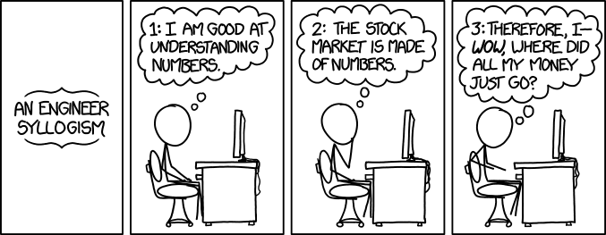
This talk begins...

Slide 7

Time Series
Is a sequence of measurements of the same variable collected over time. Most often, the measurements are taken at regular time intervals.
Notes:
Statement com foto lateral

Slide 8
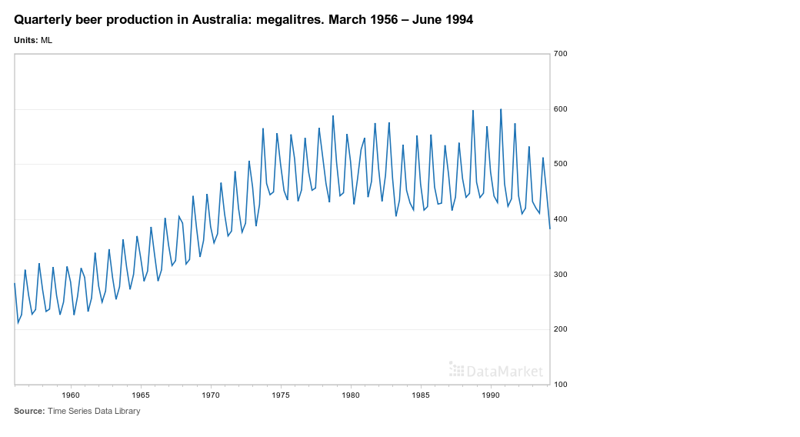
A

Slide 9
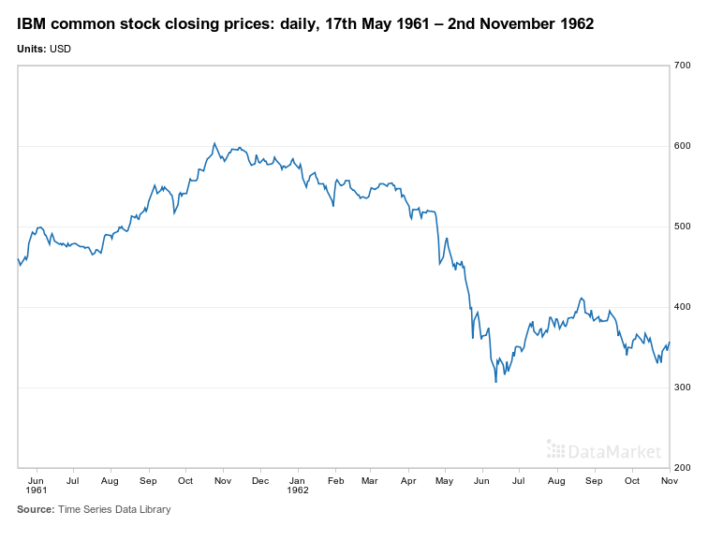
A lot

Slide 10
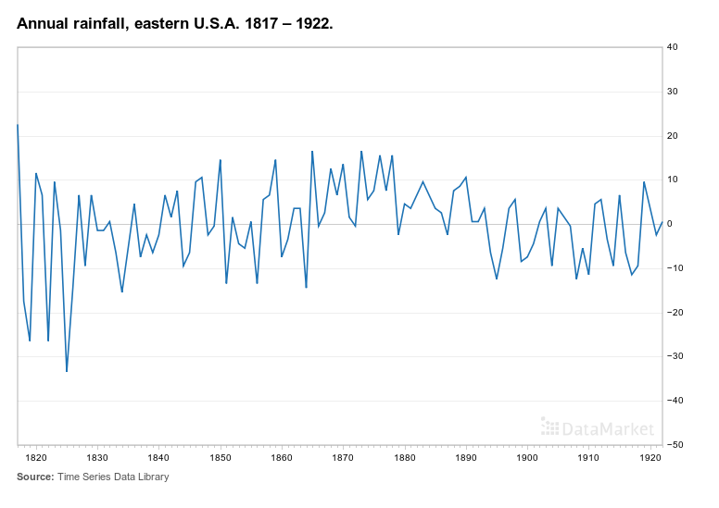
A lot of

Slide 11
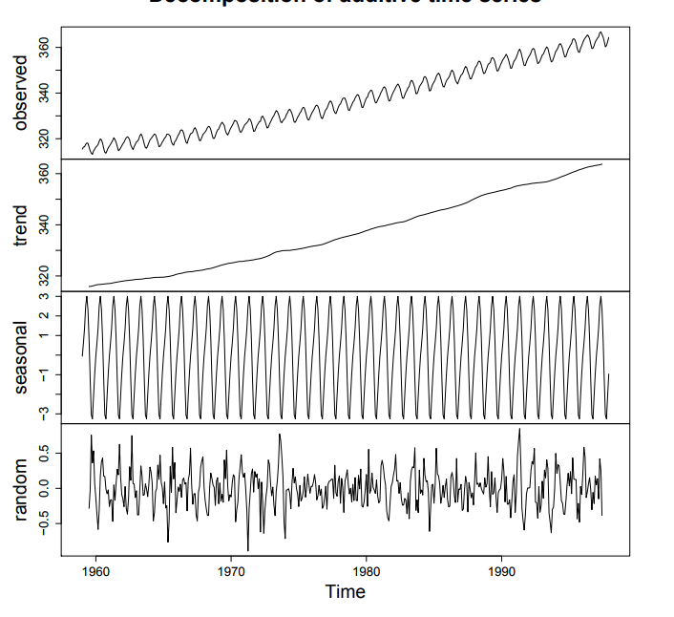
A lot of examples

Slide 12

A lot of examples of time series

Slide 13
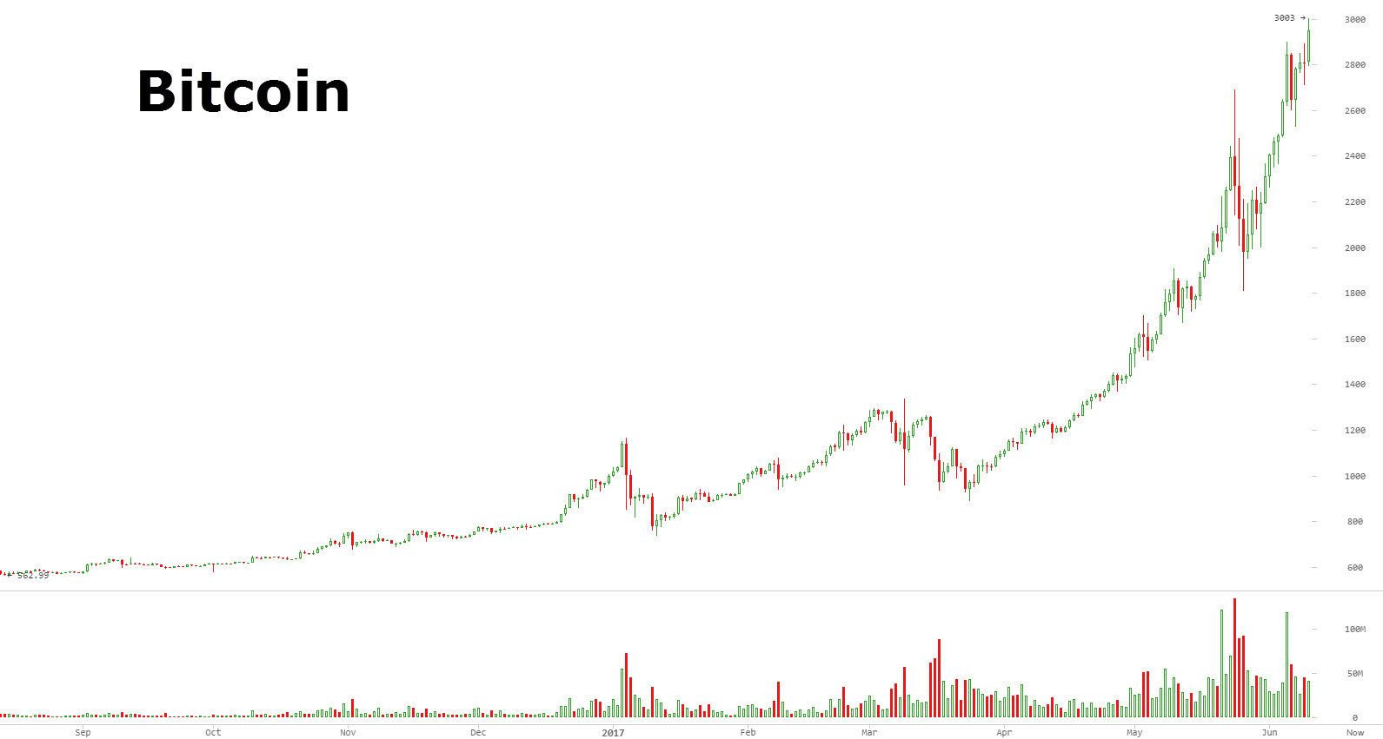
Motivation
What will be bitcoin’s price?

Slide 14

Motivation
What will be bitcoin’s price?

Slide 15
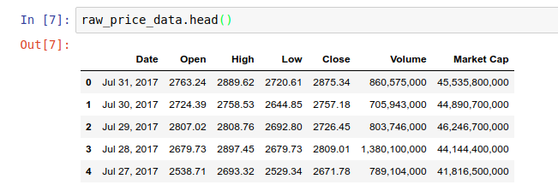
Raw data
Kaggle Competition
Until Aug 2017
Train/Test dataset
Notes:
What is time series

Slide 16
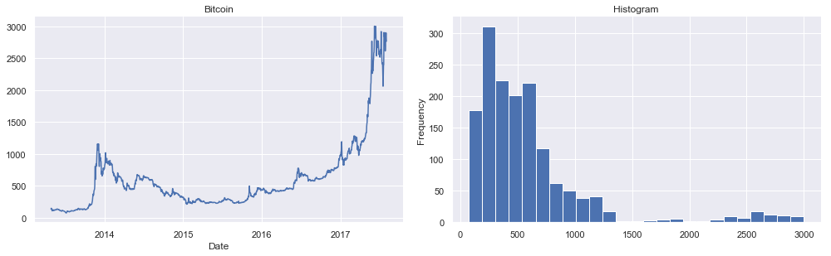
Visualizing the data
Notes:
What is time series

Slide 17

Forecasting future bitcoin
price with ARIMA
Notes:
Phrase the problem

Slide 18
ARIMA
Statistical model
Widely used to time series forecasting
Assess the stationarity of the process.
If not stationary, difference it!
Notes:
ARIMA models are the two most widely used approaches to time series forecasting

Slide 19
ARIMA
“A stationary time series is one whose properties do not depend on the time at which the series is observed”
Statistical model
Widely used to time series forecasting
Assess the stationarity of the process.
If not stationary, difference it!
Tip: More information about this topic ON THIS LINK
Notes:
ARIMA models are the two most widely used approaches to time series forecasting

Slide 20
Auto Regressive Integrated Moving Average
Autoregressive A model that uses the dependent relationship between an observation and some number of lagged observations.
Integrated The use of differencing of raw observations in order to make the time series stationary.
Moving Average A model that uses the dependency between an observation and a residual error from a moving average model applied to lagged observations.

Slide 21

Auto Regressive Integrated Moving Average
ARIMA(p, d, q)

Slide 22
Auto Regressive Integrated Moving Average
ARIMA(p, d, q)
AutoRegressive
Moving Average

Slide 23
Auto Regressive Integrated Moving Average
ARIMA(p, d, q)
p = order of the autoregressive part;
d = degree of differencing involved;
q = order of the moving average part.

Slide 24
ARIMA
Building the model
Model Identification (p, d, q)
Determine the degree of differencing (d)

Slide 25
ARIMA
Building the model
Model Identification (p, d, q)
Determine the degree of differencing (d)
Making the time series stationary
First Order Differencing
Second Order differencing
Seasonal differencing
All the above
Tip: More information about the topic here and here

Slide 26
ARIMA
Building the model
Model Identification (p, d, q)
Determine the degree of differencing
Determine the order of the ARIMA model (p, q)

Slide 27
ARIMA
Building the model
Model Identification (p, d, q)
Determine the degree of differencing
Determine the order of the ARIMA model (p, q)
Use a estimator of the relative quality of statistical models AIC (Akaike information criterion) and BIC (Bayesian information criterion)

Slide 28

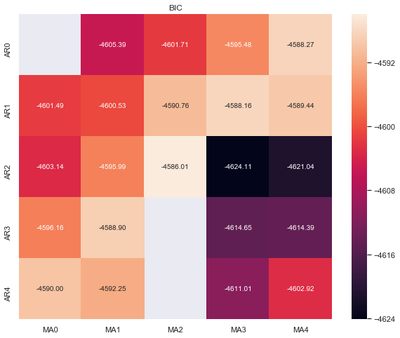
Building the model
fig, ax = plt.subplots(figsize=(10, 8)) ax = sns.heatmap(results_bic, mask=results_bic.isnull(), ax=ax, annot=True, fmt='.2f', ); ax.set_title('BIC');
import itertools p_min = 0 d_min = 0 q_min = 0 p_max = 4 d_max = 0 q_max = 4 # Initialize a DataFrame to store the results results_bic = pd.DataFrame(index=['AR{}'.format(i) for i in range(p_min,p_max+1)], columns=['MA{}'.format(i) for i in range(q_min,q_max+1)]) for p,d,q in itertools.product(range(p_min,p_max+1), range(d_min,d_max+1), range(q_min,q_max+1)): if p==0 and d==0 and q==0: r_bic.loc['AR{}'.format(p), 'MA{}'.format(q)] = np.nan continue try: model = sm.tsa.SARIMAX(series_diff2, order=(p, d, q), freq="D", #enforce_stationarity=False, #enforce_invertibility=False, ) results = model.fit() r_bic.loc['AR{}'.format(p), 'MA{}'.format(q)] = results.bic except: continue
results_bic = r_bic[r_bic.columns].astype(float)
fig, ax = plt.subplots(figsize=(10, 8)) ax = sns.heatmap(results_bic, mask=results_bic.isnull(), ax=ax, annot=True, fmt='.2f', ); ax.set_title('BIC');

Slide 29
Building the model
import statsmodels.api as sm
arima203 = sm.tsa.SARIMAX(series_diff2, order=(2, 0, 3), freq='D')
model_results = arima203.fit()
model_results.plot_diagnostics()

Slide 30
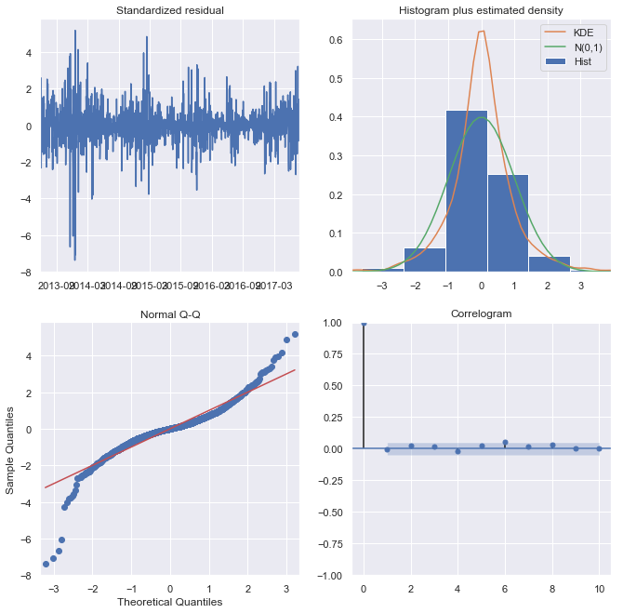
Building the model
import statsmodels.api as sm
arima203 = sm.tsa.SARIMAX(series_diff2, order=(2, 0, 3), freq='D')
model_results = arima203.fit()
model_results.plot_diagnostics()

Slide 31
Long Term Forecast
ts_test = raw_price_test_data['High'] ts_test = np.log(ts_test).diff().diff(1).dropna() # get forecast 120 steps ahead in future pred_uc = model_results.get_forecast(steps=120) # get confidence intervals of forecasts pred_ci = pred_uc.conf_int() # plot time series and long-term forecast ax = series_diff2.loc['2017':].plot(label='Observed',
figsize=(16, 8), color='#006699') pred_uc.predicted_mean.plot(ax=ax, label='Forecast',
color='#975075'); ts_test.plot(ax=ax, label="Test Data", color="green") ax.fill_between(pred_ci.index, pred_ci.iloc[:, 0], pred_ci.iloc[:, 1], color='black',
alpha=.25)
ax.set_xlabel('Date'); ax.set_ylabel('Price'); plt.legend(loc='upper left') plt.show()

Slide 32
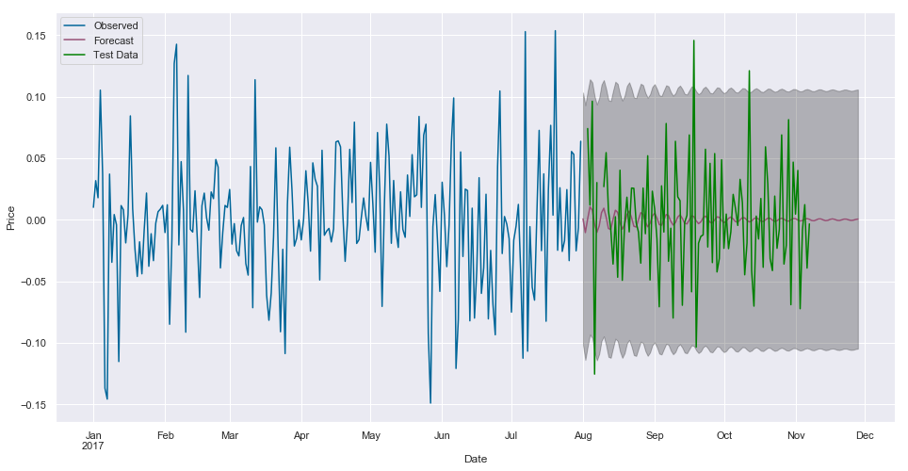
Long Term Forecast
ts_test = raw_price_test_data['High'] ts_test = np.log(ts_test).diff().diff(1).dropna() # get forecast 120 steps ahead in future pred_uc = model_results.get_forecast(steps=120) # get confidence intervals of forecasts pred_ci = pred_uc.conf_int() # plot time series and long-term forecast ax = series_diff2.loc['2017':].plot(label='Observed',
figsize=(16, 8), color='#006699') pred_uc.predicted_mean.plot(ax=ax, label='Forecast',
color='#975075'); ts_test.plot(ax=ax, label="Test Data", color="green") ax.fill_between(pred_ci.index, pred_ci.iloc[:, 0], pred_ci.iloc[:, 1], color='black',
alpha=.25)
ax.set_xlabel('Date'); ax.set_ylabel('Price'); plt.legend(loc='upper left') plt.show()
Observed
Forecast
Test Data

Slide 33

Long Term Forecast
ts_test = raw_price_test_data['High'] ts_test = np.log(ts_test).diff().diff(1).dropna() # get forecast 120 steps ahead in future pred_uc = model_results.get_forecast(steps=120) # get confidence intervals of forecasts pred_ci = pred_uc.conf_int() # plot time series and long-term forecast ax = series_diff2.loc['2017':].plot(label='Observed',
figsize=(16, 8), color='#006699') pred_uc.predicted_mean.plot(ax=ax, label='Forecast',
color='#975075'); ts_test.plot(ax=ax, label="Test Data", color="green") ax.fill_between(pred_ci.index, pred_ci.iloc[:, 0], pred_ci.iloc[:, 1], color='black',
alpha=.25)
ax.set_xlabel('Date'); ax.set_ylabel('Price'); plt.legend(loc='upper left') plt.show()
Observed
Forecast
Test Data

Slide 34
Where ARIMA shines
It works best when your data exhibits a stable or consistent pattern over time
Minimum amount of outliers.

Slide 35

Forecasting future bitcoin
price with Prophet
Notes:
Phrase the problem

Slide 36
Prophet
Prophet is a procedure for forecasting time series data
Developed by Facebook
Easier for experts and non-experts to make high quality forecasts
Doesn’t require the series to be stationary

Slide 37
Prophet
It’s an additive regression model with four main components:
A piecewise linear or logistic growth curve trend.
A yearly seasonal component modeled using Fourier series.
A weekly seasonal component using dummy variables.
A user-provided list of important holidays.

Slide 38
Building the model
from fbprophet import Prophet n = pd.DataFrame({'ds': raw_price_data['High'].index, 'y': raw_price_data['High'].values}) m = Prophet(interval_width=0.95, daily_seasonality=True) m.fit(n) future = m.make_future_dataframe(periods=365) forecast = m.predict(future) m.plot(forecast) raw_price_test_data['High'].plot(label="Test Data", color="green") plt.figure(figsize=(15,5)) plt.plot(raw_price_data.index, raw_price_data['High']) plt.ylabel('Bitcoin price'); m.plot_components(forecast) plt.show()

Slide 39
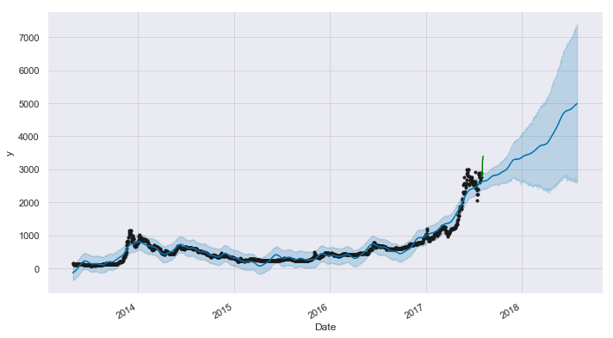
Building the model
from fbprophet import Prophet n = pd.DataFrame({'ds': raw_price_data['High'].index, 'y': raw_price_data['High'].values}) m = Prophet(interval_width=0.95, daily_seasonality=True) m.fit(n) future = m.make_future_dataframe(periods=365) forecast = m.predict(future) m.plot(forecast) raw_price_test_data['High'].plot(label="Test Data", color="green") plt.figure(figsize=(15,5)) plt.plot(raw_price_data.index, raw_price_data['High']) plt.ylabel('Bitcoin price'); m.plot_components(forecast) plt.show()

Slide 40
Where Prophet shines
Hourly, daily, or weekly observations with at least a few months (preferably a year) of history
Strong multiple “human-scale” seasonalities: day of week and time of year
Important holidays that occur at irregular intervals that are known in advance (e.g. the Super Bowl)
A reasonable number of missing observations or large outliers

Slide 41

Forecasting future bitcoin
price with Neural Networks
Notes:
Phrase the problem

Slide 42

LSTM
Machine learning model
LSTM stands for Long Short-Term Memory
Recurrent Neural Network
Have some internal contextual state cells that act as long-term or short-term memory cells

Slide 43
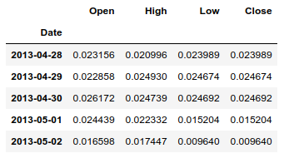
Scale the series
from sklearn.preprocessing import MinMaxScaler df = raw_price_data df.drop(['Volume', 'Market Cap'], 1, inplace=True) min_max_scaler = MinMaxScaler() df['Open'] = min_max_scaler.fit_transform(df.Open.values.reshape(-1,1)) df['High'] = min_max_scaler.fit_transform(df.High.values.reshape(-1,1)) df['Low'] = min_max_scaler.fit_transform(df.Low.values.reshape(-1,1)) df['Close'] = min_max_scaler.fit_transform(df.Low.values.reshape(-1,1)) df.head()
ARIMA

Slide 44
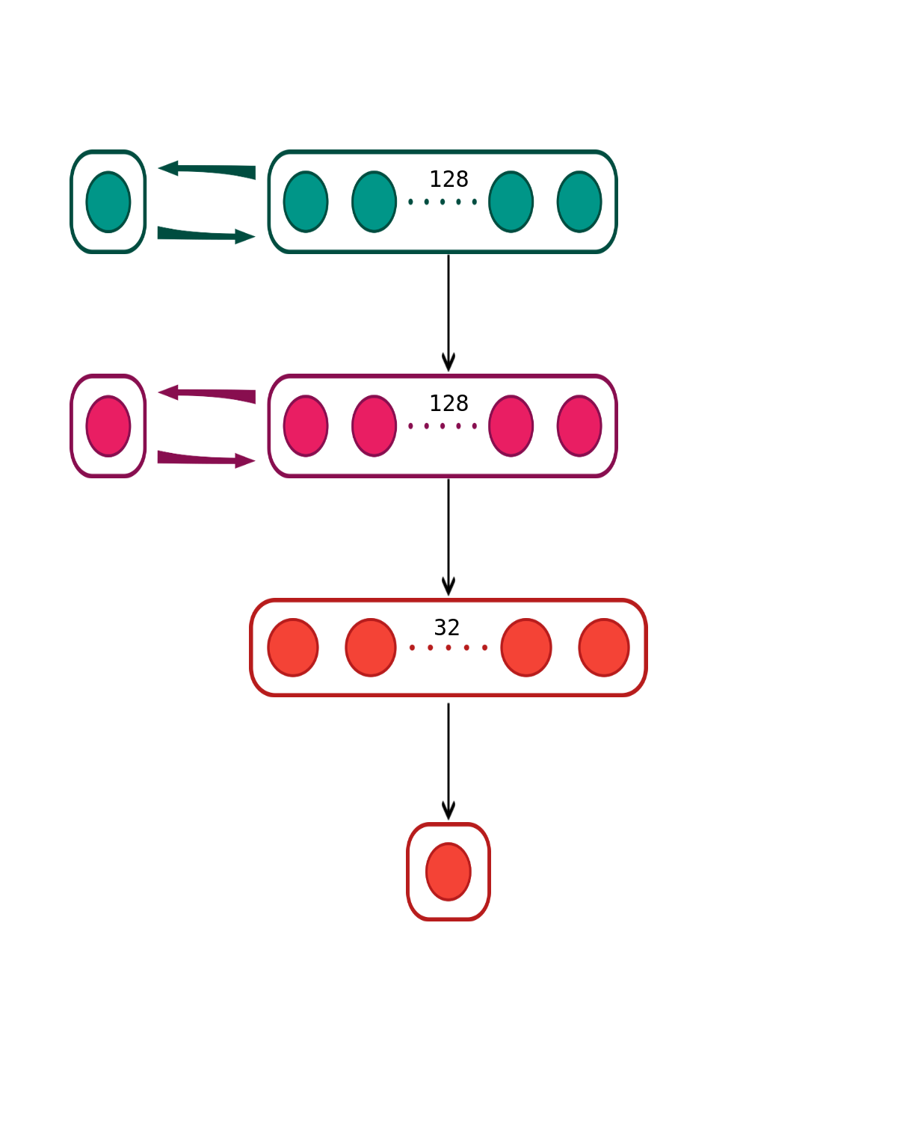
Building the model
from keras.models import Sequential from keras.layers import Dense, LSTM, Activation
x_train, y_train, x_test, y_test = load_data(df, seq_len) model = Sequential() model.add(LSTM(neurons[0], input_shape=(layers[1],
layers[0]), return_sequences=True)) model.add(LSTM(neurons[1], input_shape=(layers[1],
layers[0]), return_sequences=False)) model.add(Dense(neurons[2], kernel_initializer="uniform",
activation='relu')) model.add(Dense(neurons[3], kernel_initializer="uniform",
activation='linear')) model.compile(loss='mse',optimizer='adam', metrics=['accuracy']) model.fit(x_train, y_train, batch_size=512, epochs=epochs, validation_split=0.1, verbose=0, shuffle=False) test_predict = model.predict(x_test) plt.plot(test_predict, color='red', label='Prediction') plt.plot(y_test,color='blue', label='Actual') plt.legend(loc='best') plt.title('The test result for {}'.format("Bitcoin price")) plt.xlabel('Days') plt.ylabel('Price') plt.show()
model = Sequential() model.add(LSTM(neurons[0], input_shape=(layers[1], layers[0]),
return_sequences=True)) model.add(LSTM(neurons[1], input_shape=(layers[1], layers[0]),
return_sequences=False)) model.add(Dense(neurons[2], kernel_initializer="uniform",
activation='relu')) model.add(Dense(neurons[3], kernel_initializer="uniform",
activation='linear'))

Slide 45
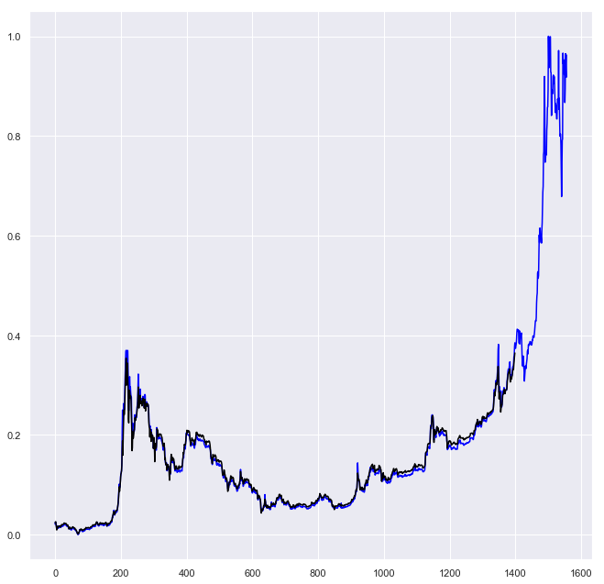
Building the model
from keras.models import Sequential from keras.layers import Dense, LSTM, Activation
x_train, y_train, x_test, y_test = load_data(df, seq_len) model = Sequential() model.add(LSTM(neurons[0], input_shape=(layers[1],
layers[0]), return_sequences=True)) model.add(LSTM(neurons[1], input_shape=(layers[1],
layers[0]), return_sequences=False)) model.add(Dense(neurons[2], kernel_initializer="uniform",
activation='relu')) model.add(Dense(neurons[3], kernel_initializer="uniform",
activation='linear')) model.compile(loss='mse',optimizer='adam', metrics=['accuracy']) model.fit(x_train, y_train, batch_size=512, epochs=epochs, validation_split=0.1, verbose=0, shuffle=False) test_predict = model.predict(x_test) plt.plot(test_predict, color='red', label='Prediction') plt.plot(y_test,color='blue', label='Actual') plt.legend(loc='best') plt.title('The test result for {}'.format("Bitcoin price")) plt.xlabel('Days') plt.ylabel('Price') plt.show()
model.compile(loss='mse',optimizer='adam',metrics=['accuracy'])
model.fit(x_train, y_train, batch_size=512, epochs=epochs, validation_split=0.1, verbose=0, shuffle=False)

Slide 46
Building the model
from keras.models import Sequential from keras.layers import Dense, LSTM, Activation
x_train, y_train, x_test, y_test = load_data(df, seq_len) model = Sequential() model.add(LSTM(neurons[0], input_shape=(layers[1],
layers[0]), return_sequences=True)) model.add(LSTM(neurons[1], input_shape=(layers[1],
layers[0]), return_sequences=False)) model.add(Dense(neurons[2], kernel_initializer="uniform",
activation='relu')) model.add(Dense(neurons[3], kernel_initializer="uniform",
activation='linear')) model.compile(loss='mse',optimizer='adam', metrics=['accuracy']) model.fit(x_train, y_train, batch_size=512, epochs=epochs, validation_split=0.1, verbose=0, shuffle=False) test_predict = model.predict(x_test) plt.plot(test_predict, color='red', label='Prediction') plt.plot(y_test,color='blue', label='Actual') plt.legend(loc='best') plt.title('The test result for {}'.format("Bitcoin price")) plt.xlabel('Days') plt.ylabel('Price') plt.show()
test_predict = model.predict(x_test)

Slide 47
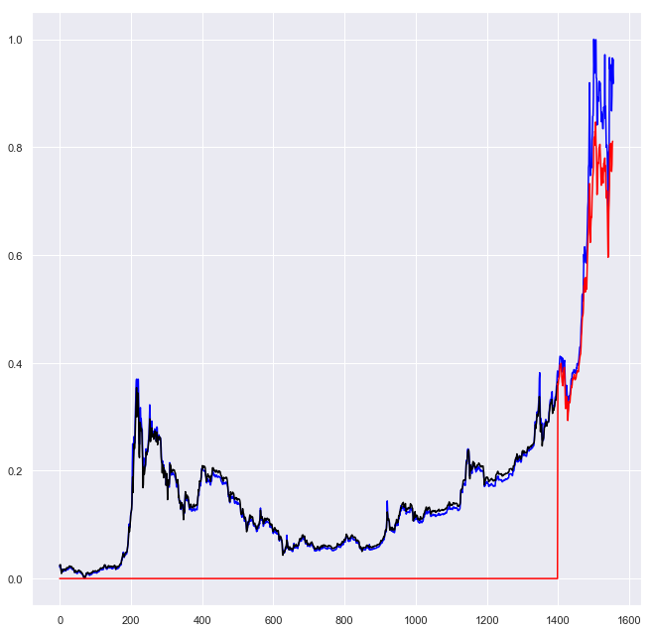
Building the model
from keras.models import Sequential from keras.layers import Dense, LSTM, Activation
x_train, y_train, x_test, y_test = load_data(df, seq_len) model = Sequential() model.add(LSTM(neurons[0], input_shape=(layers[1],
layers[0]), return_sequences=True)) model.add(LSTM(neurons[1], input_shape=(layers[1],
layers[0]), return_sequences=False)) model.add(Dense(neurons[2], kernel_initializer="uniform",
activation='relu')) model.add(Dense(neurons[3], kernel_initializer="uniform",
activation='linear')) model.compile(loss='mse',optimizer='adam', metrics=['accuracy']) model.fit(x_train, y_train, batch_size=512, epochs=epochs, validation_split=0.1, verbose=0, shuffle=False) test_predict = model.predict(x_test) plt.plot(test_predict, color='red', label='Prediction') plt.plot(y_test,color='blue', label='Actual') plt.legend(loc='best') plt.title('The test result for {}'.format("Bitcoin price")) plt.xlabel('Days') plt.ylabel('Price') plt.show()
test_predict = model.predict(x_test)

Slide 48

Building the model
from keras.models import Sequential from keras.layers import Dense, LSTM, Activation
x_train, y_train, x_test, y_test = load_data(df, seq_len) model = Sequential() model.add(LSTM(neurons[0], input_shape=(layers[1],
layers[0]), return_sequences=True)) model.add(LSTM(neurons[1], input_shape=(layers[1],
layers[0]), return_sequences=False)) model.add(Dense(neurons[2], kernel_initializer="uniform",
activation='relu')) model.add(Dense(neurons[3], kernel_initializer="uniform",
activation='linear')) model.compile(loss='mse',optimizer='adam', metrics=['accuracy']) model.fit(x_train, y_train, batch_size=512, epochs=epochs, validation_split=0.1, verbose=0, shuffle=False) test_predict = model.predict(x_test) plt.plot(test_predict, color='red', label='Prediction') plt.plot(y_test,color='blue', label='Actual') plt.legend(loc='best') plt.title('The test result for {}'.format("Bitcoin price")) plt.xlabel('Days') plt.ylabel('Price') plt.show()
test_predict = model.predict(x_test)

Slide 49
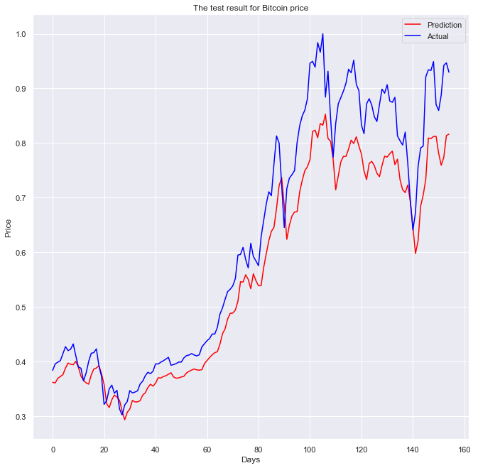
Building the model
from keras.models import Sequential from keras.layers import Dense, LSTM, Activation
x_train, y_train, x_test, y_test = load_data(df, seq_len) model = Sequential() model.add(LSTM(neurons[0], input_shape=(layers[1],
layers[0]), return_sequences=True)) model.add(LSTM(neurons[1], input_shape=(layers[1],
layers[0]), return_sequences=False)) model.add(Dense(neurons[2], kernel_initializer="uniform",
activation='relu')) model.add(Dense(neurons[3], kernel_initializer="uniform",
activation='linear')) model.compile(loss='mse',optimizer='adam', metrics=['accuracy']) model.fit(x_train, y_train, batch_size=512, epochs=epochs, validation_split=0.1, verbose=0, shuffle=False) test_predict = model.predict(x_test) plt.plot(test_predict, color='red', label='Prediction') plt.plot(y_test,color='blue', label='Actual') plt.legend(loc='best') plt.title('The test result for {}'.format("Bitcoin price")) plt.xlabel('Days') plt.ylabel('Price') plt.show()
test_predict = model.predict(x_test)

Slide 50
Where LSTM shines
Text generation
Handwriting recognition
Music generation
Language translation
Infinite possibilities

Slide 51

Where LSTM shines
Text generation
Handwriting recognition
Music generation
Language translation
Infinite possibilities

Slide 52
Comparative
ARIMA
Data exhibits a stable pattern over time
Requires the series to be stationary
Prophet
Made for experts and non-experts
Don’t require the series to be stationary
LSTM
Act as long-term or short-term memory cells
Can be applied to a different range of problems

Slide 53

Thank you!
Got any questions?
Rebeca Sarai
Software Developer
rebeca@vinta.com.br
@_rebecasarai
/rsarai
Access this talk on bit.ly/pygotham-time-series
Code of this talk available on bit.ly/pygotham-ts-code

Slide 54
More References
https://otexts.org/fpp2/
https://github.com/etcrago/Tutorial-Arima-w-jeffrey-yau/
https://www.youtube.com/watch?v=_vQ0W_qXMxk
http://dacatay.com/data-science/comprehensive-guide-time-series-analytics-visualization-prediction-python/

